Slide 1
data analysis system at CSNS DU Rong Data Analysis & Software Group 2019.4.3

Slide 2
Outline
CSNS
overview
Data analysis
Online software
Offline software
User system and data management
User service platform
Data portal
Unified authentication
Data management

Slide 3
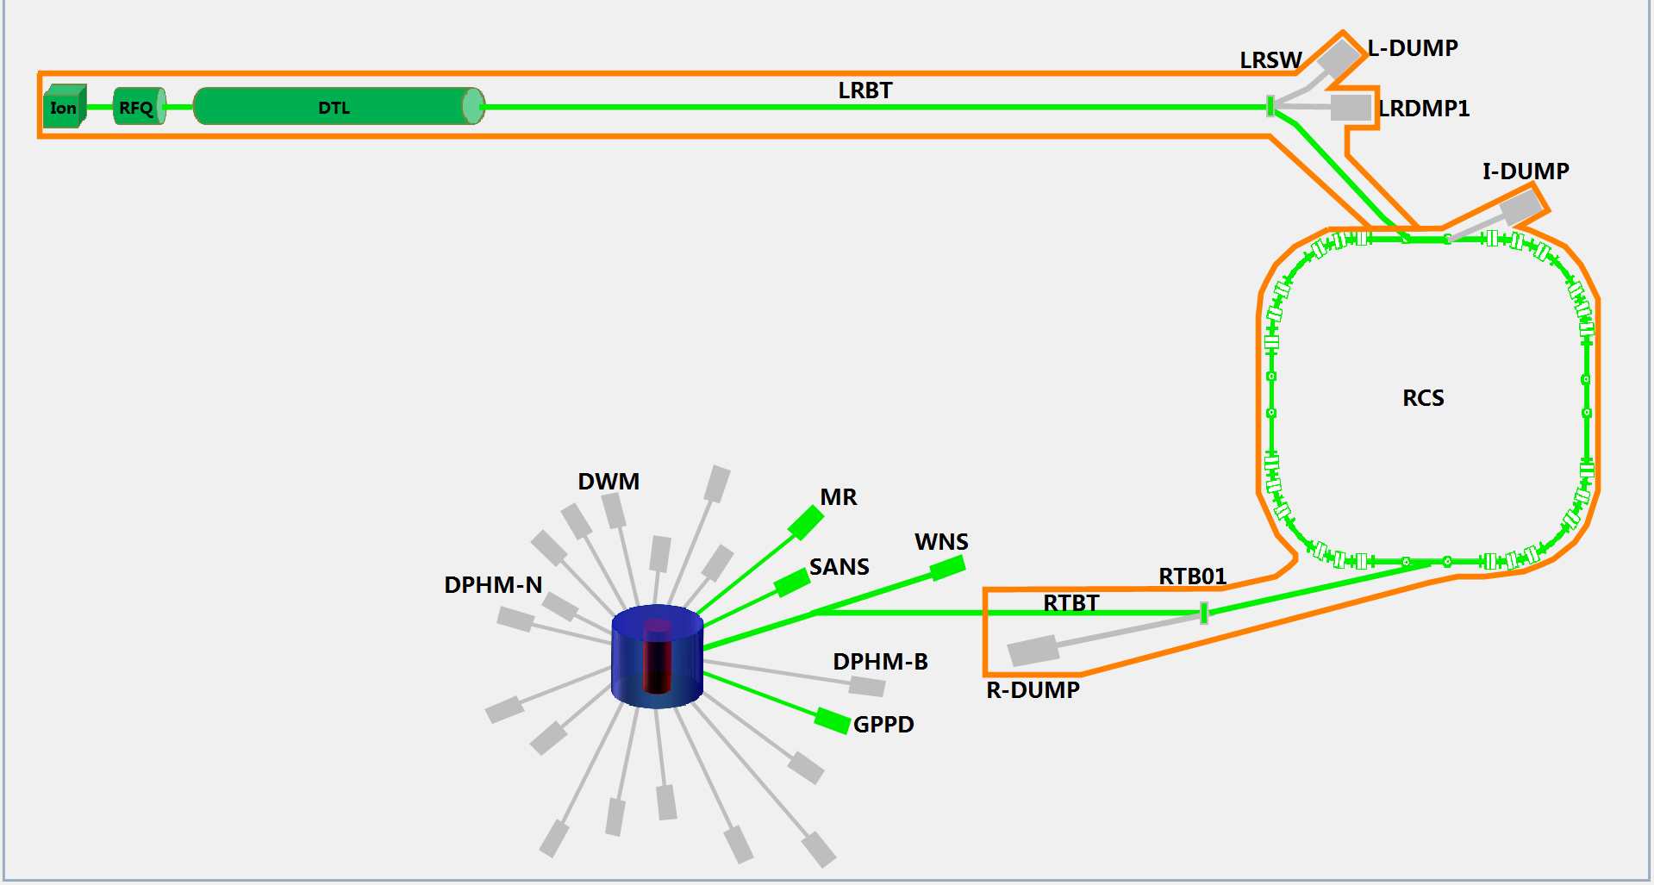
CSNS
80 MeV H- linac
1.6 GeV
25 Hz
100 kW
Budget: 2.3 BCNY
Tungsten target
3 beam lines/20

Slide 4
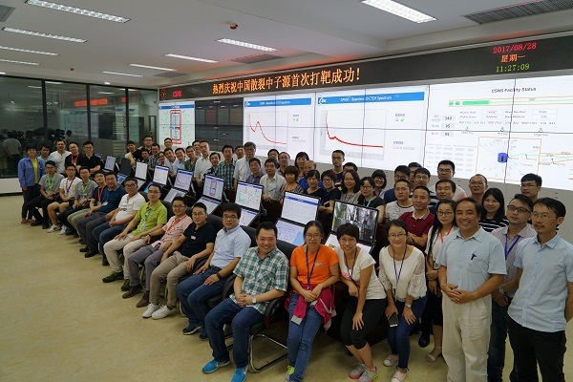
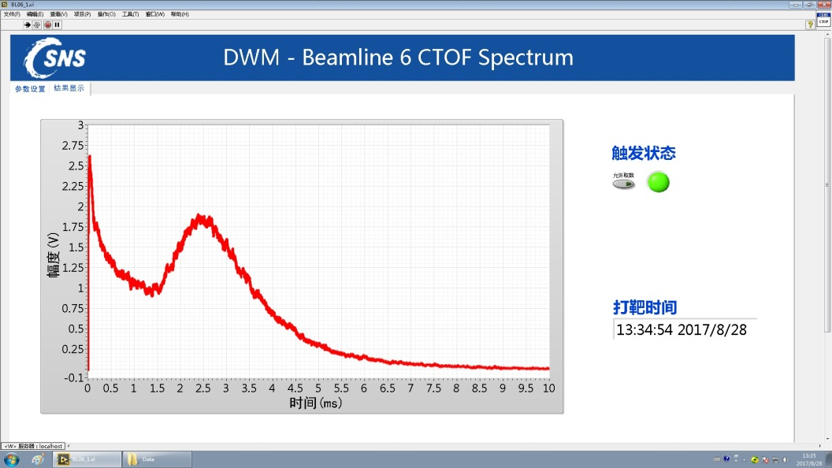
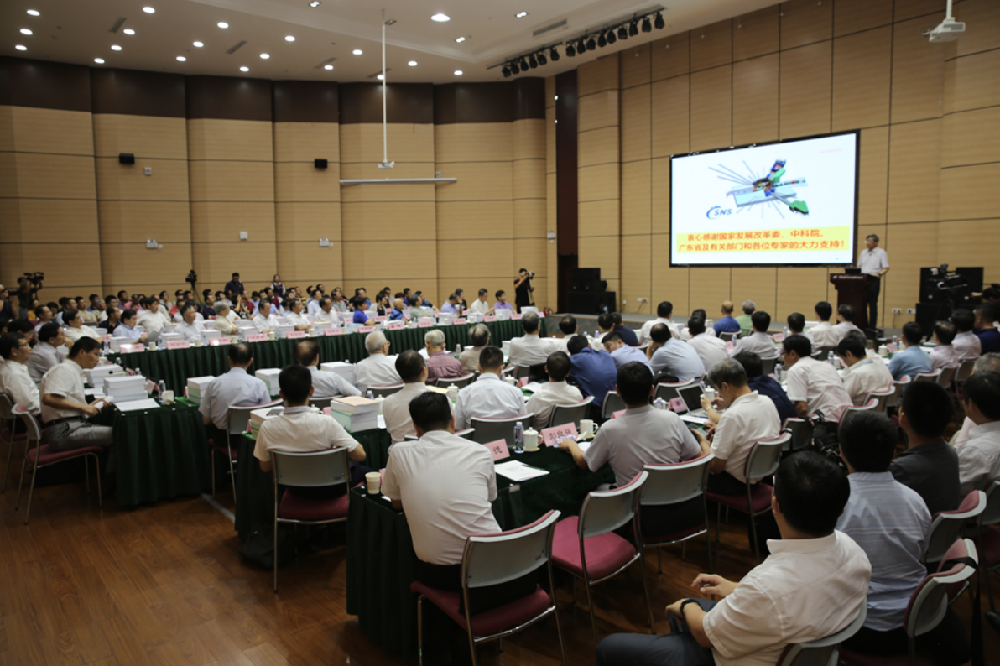
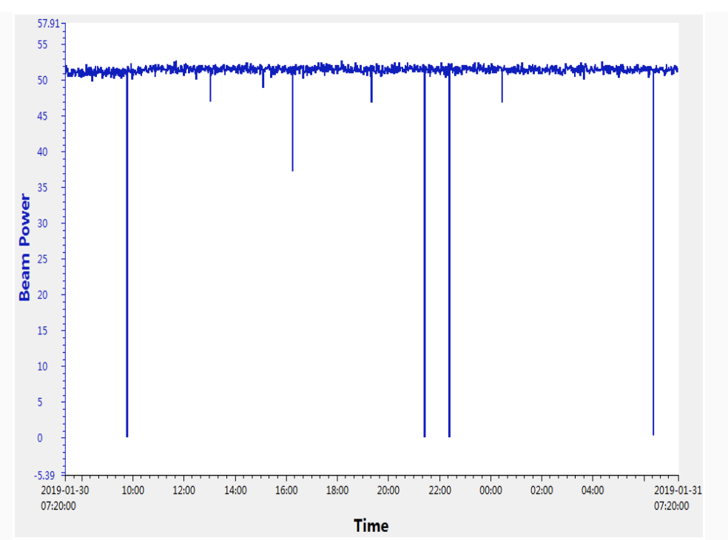
Aug, 2018, passed the national acceptance and opened to users
Aug. 28, 2017, first neutron pulse
Jan, 2019, up to 50 kW, plan to 80 kW at the end of this year, 100 kW in 2021.
4

Slide 5
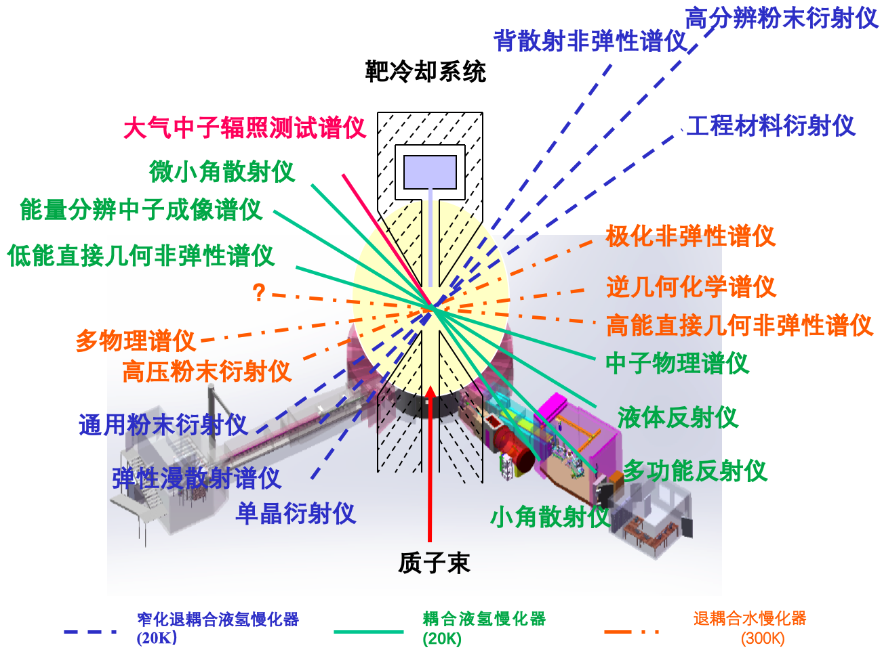
BS
HRPD
Under construction
irradiation
VSANS
ED
image
Under construction
Polarized
LE direct
indirect
MPI
HE direct
HPPD
NP
GPPD
LR
DS
MR
Single-crystal
SANS
 | Elastic (structure) | Inelastic (dynamic) | Quasi-elastic | Image | others
In operation | 3 | 0 | 0 | 0 | 0
Under construction | 5 | 0 | 0 | 1 | 1
Planning stage | 2 | 4 | 2 | 0 | 1

Slide 6
Outline
CSNS
overview
Data analysis
Online software
Offline software
User system and data management
User service platform
Data portal
Unified authentication
Data management

Slide 7



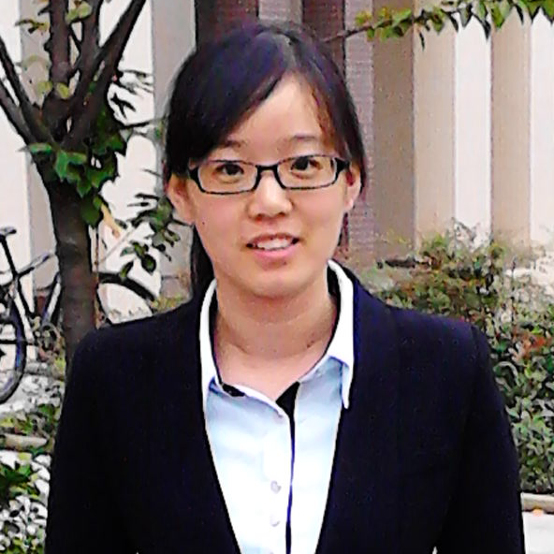


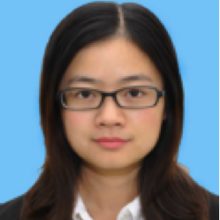
Online Software
Software Control
Cockpit
Software Monitor
Olms (Glassfish)
Detector
(DIM)
Data
Caching
NEON
Monitor
(EPICS V4)
Visualization
Pilot
Charge
(EPICS)
NEON
Data Reconstruction
Drone
Data Reduction
Mantid

Slide 8
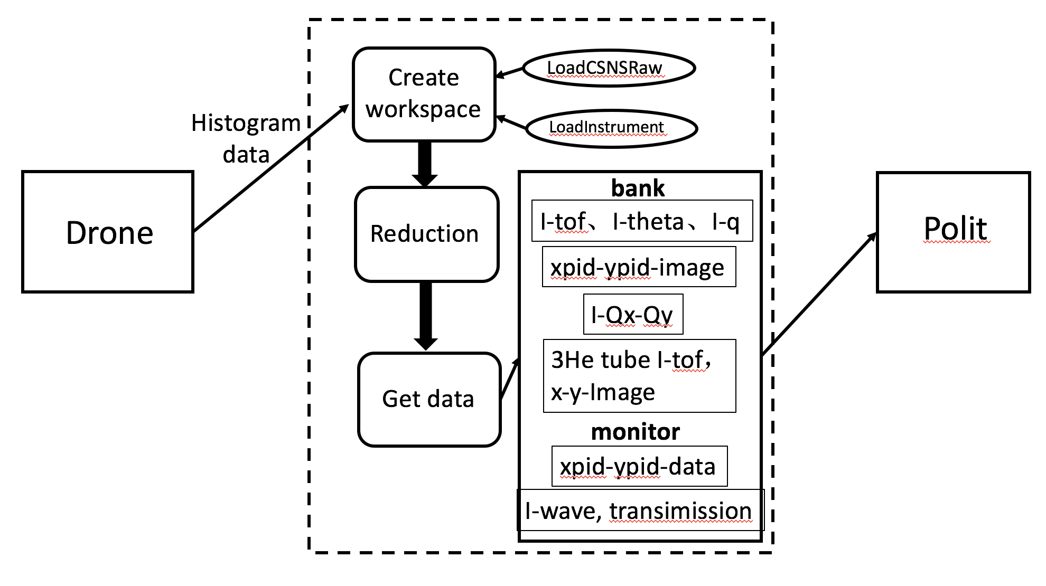
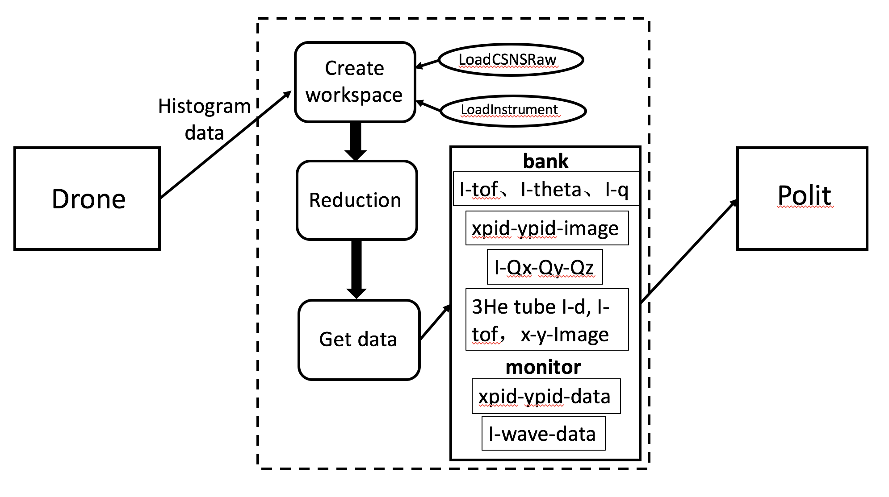
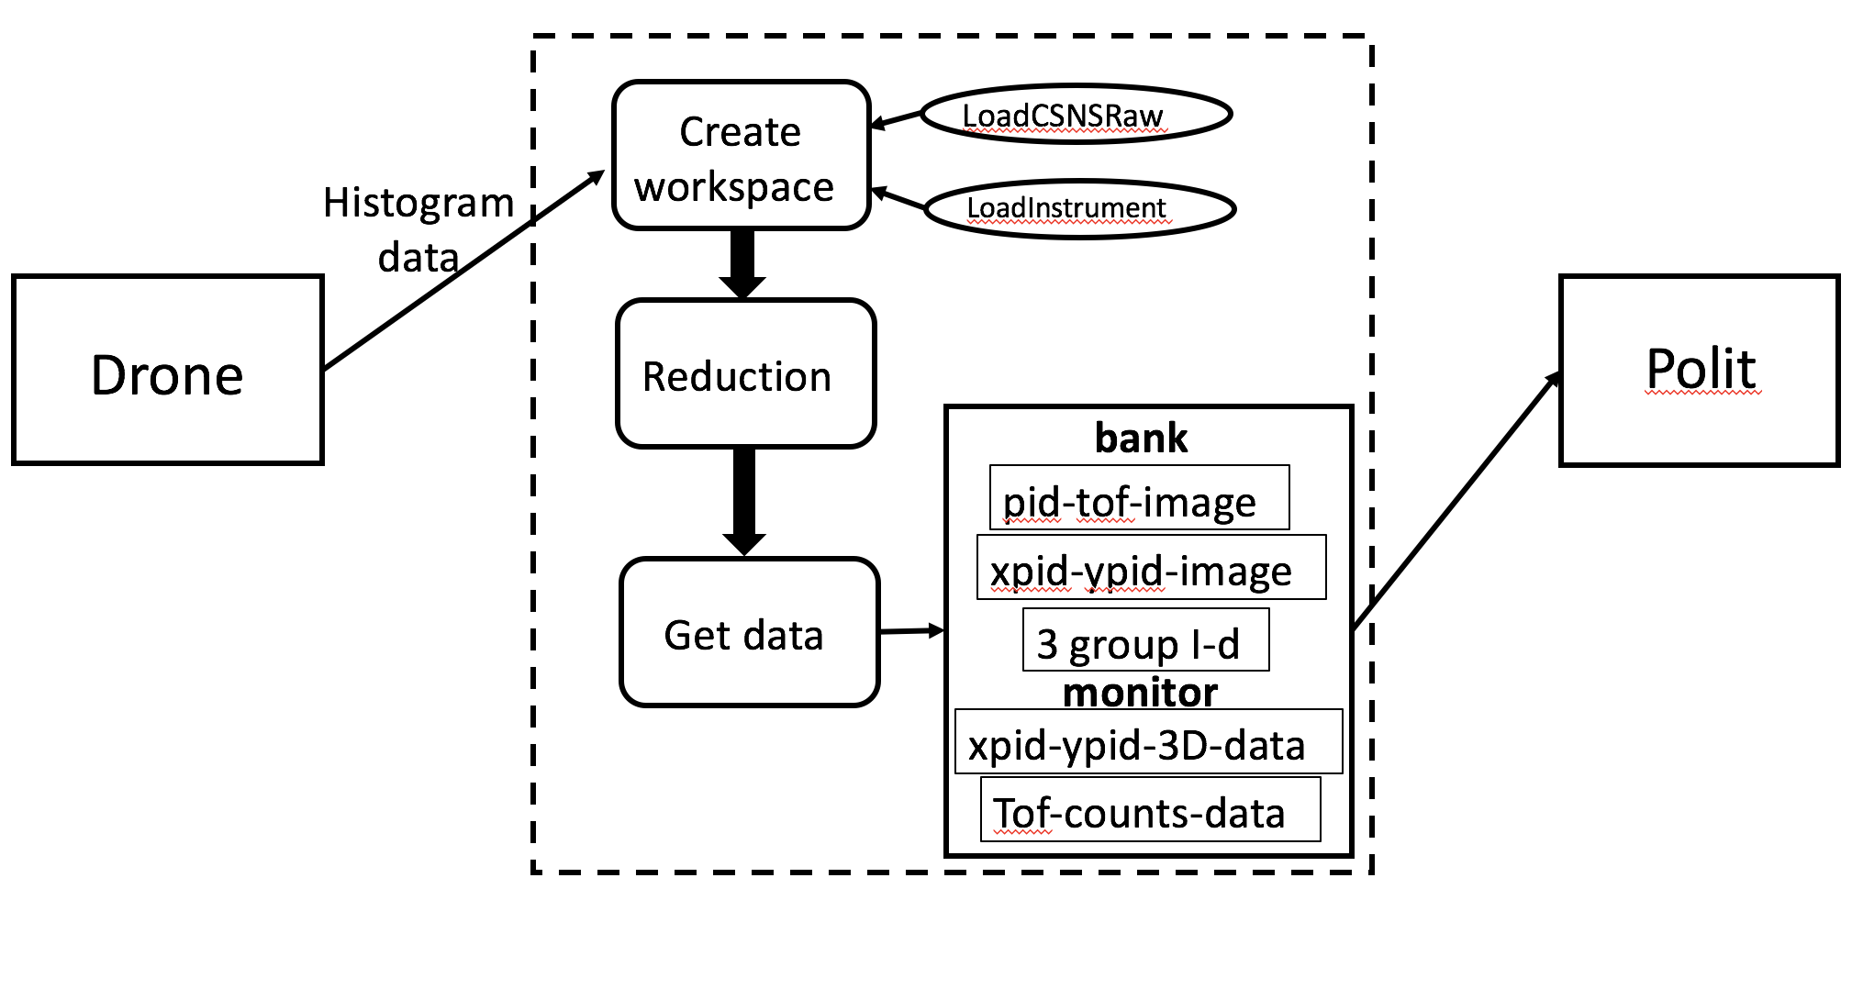
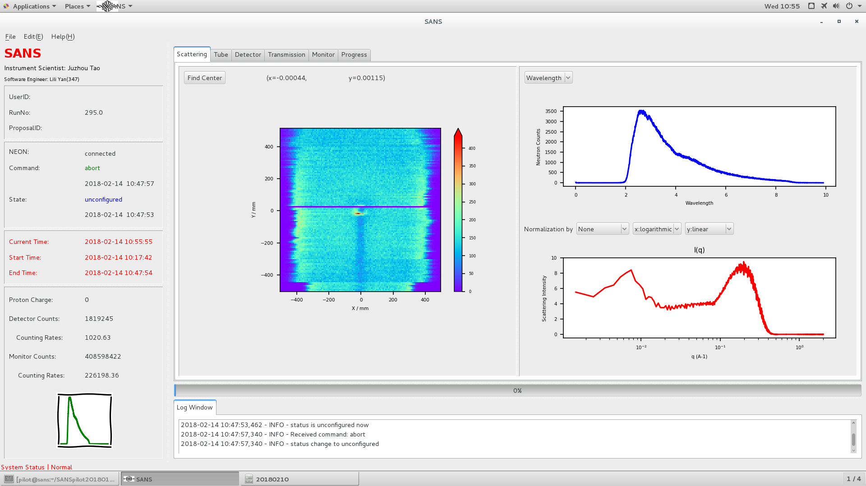
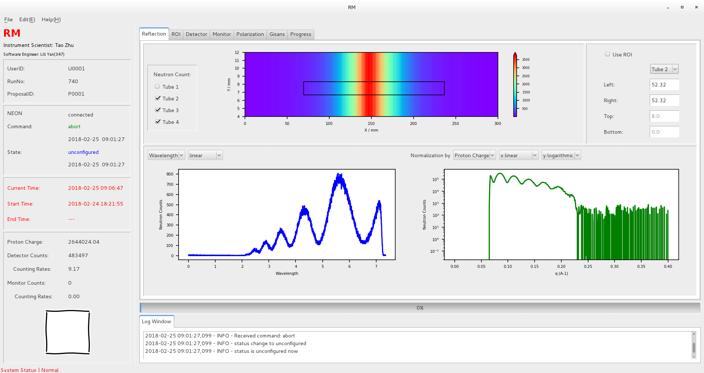
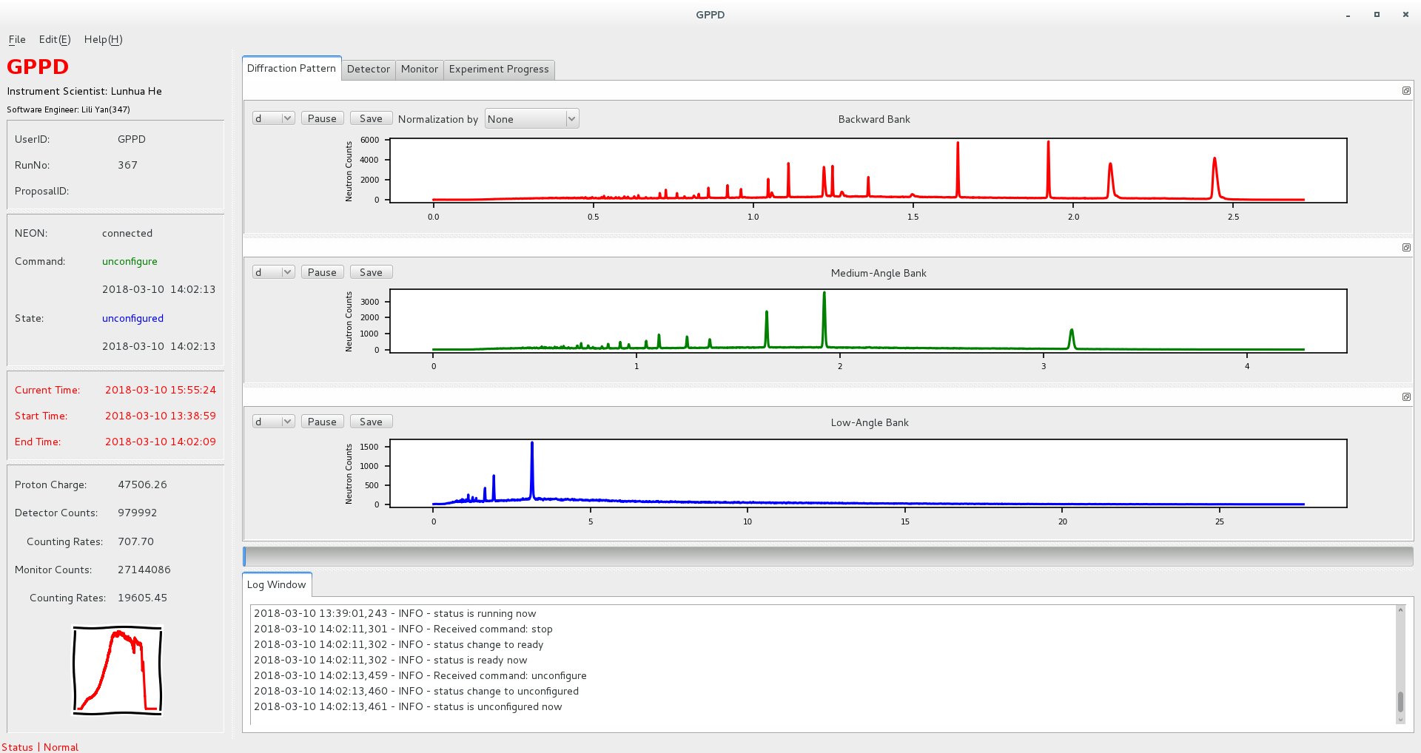
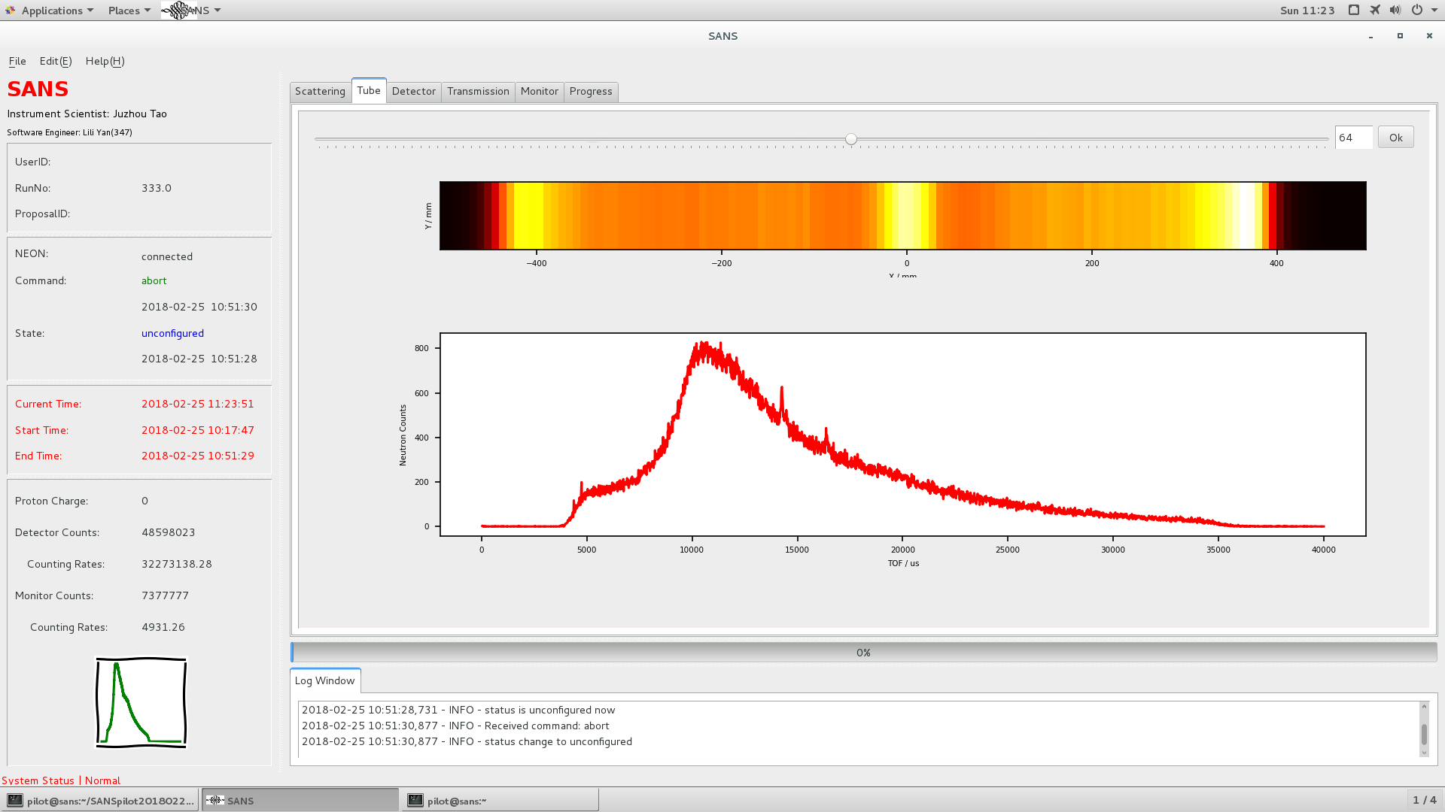
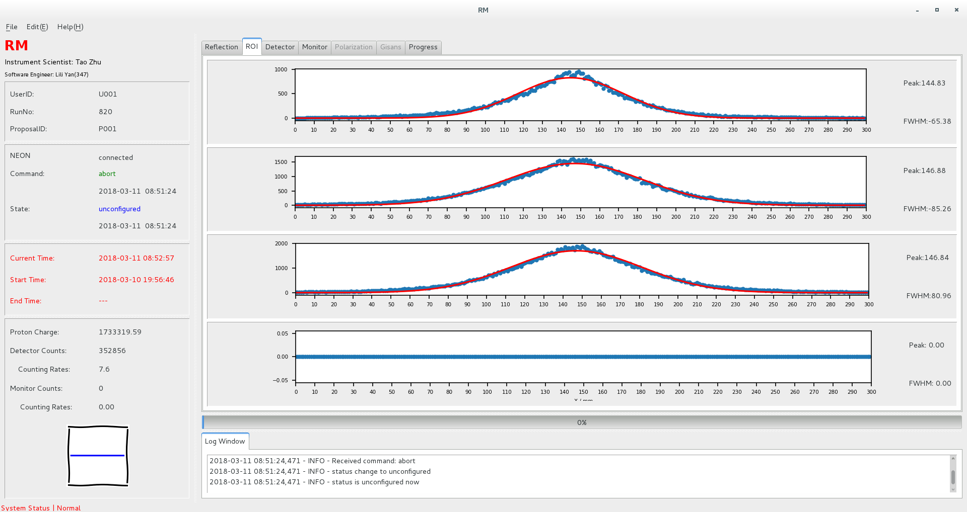
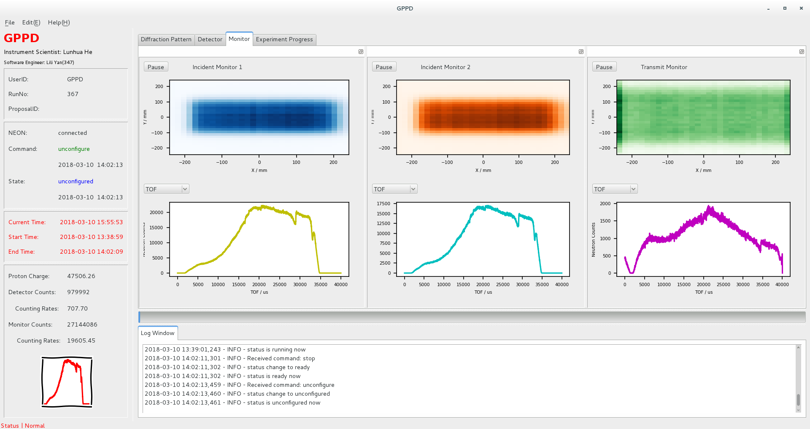
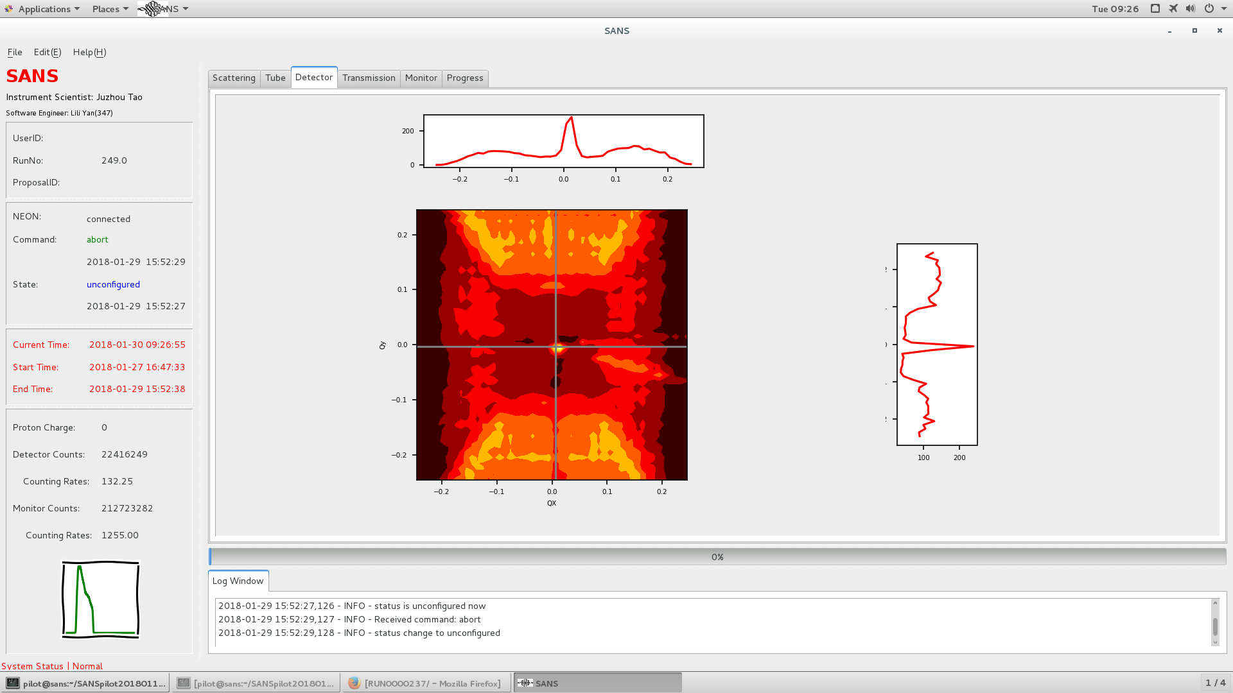
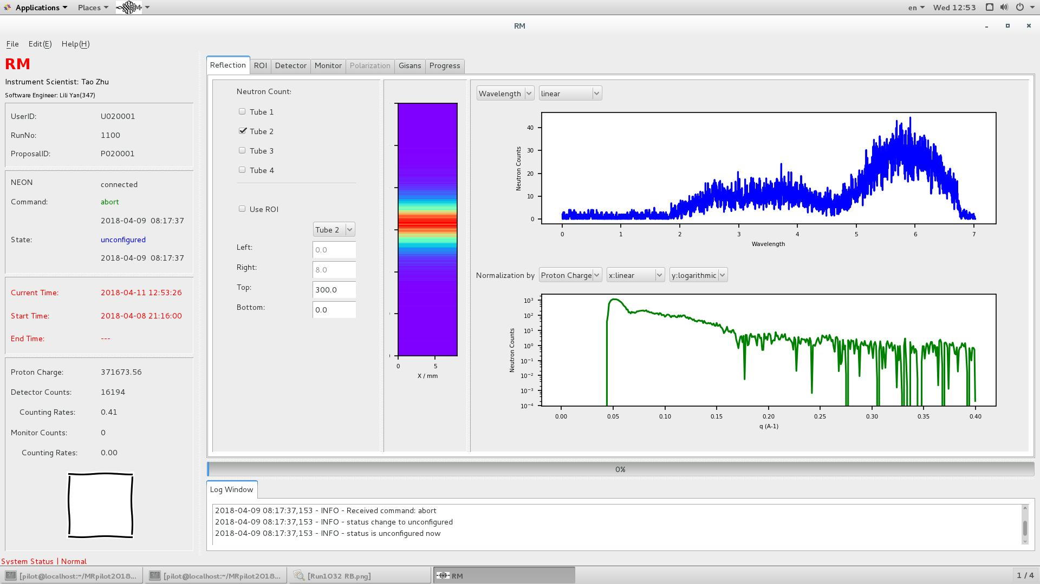
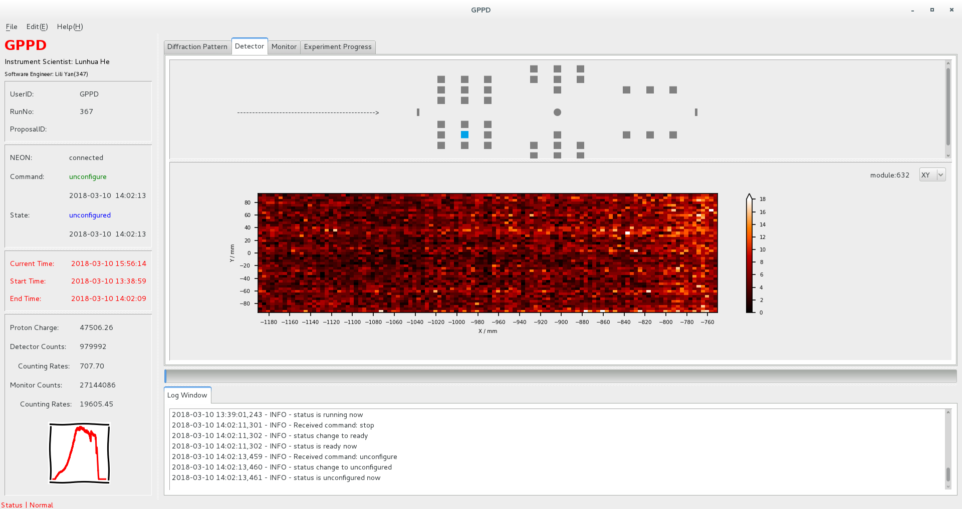
Online software
SANS
MR
GPPD
quasi-realtime,
no sampling,
full-function
Client-Server mode
MVP design mode

Slide 9

Offline software:
Raw data
NeXus
CSNS instrument
Reduction
Algorithm
Python
+
Qt4
GUI
IDF
workspace
summary
Data reconstruction
(C++)
Data reduction
(python)

Slide 10
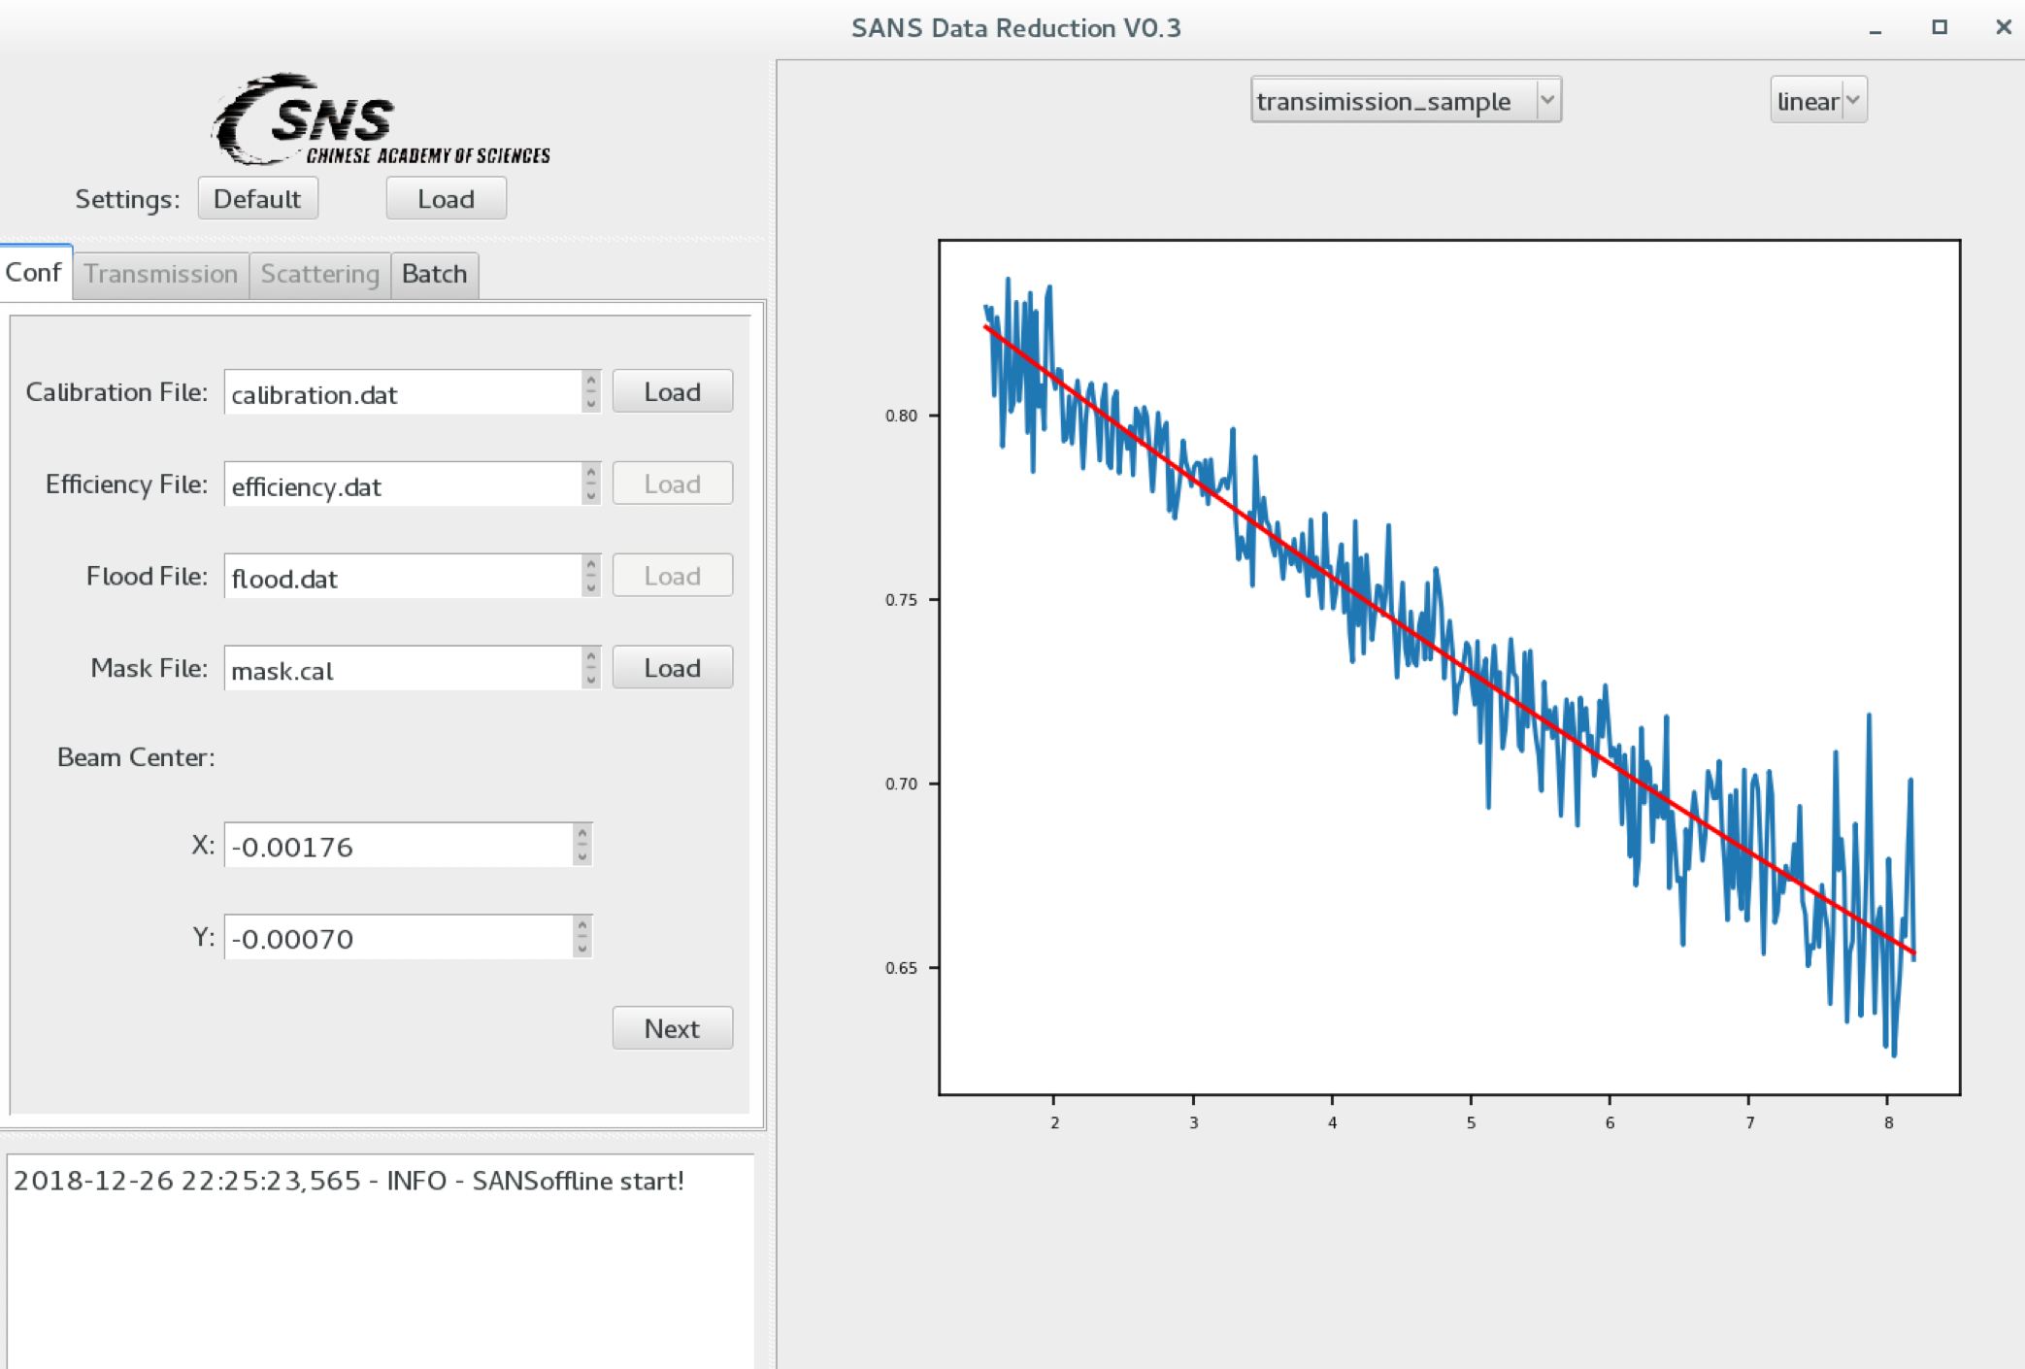
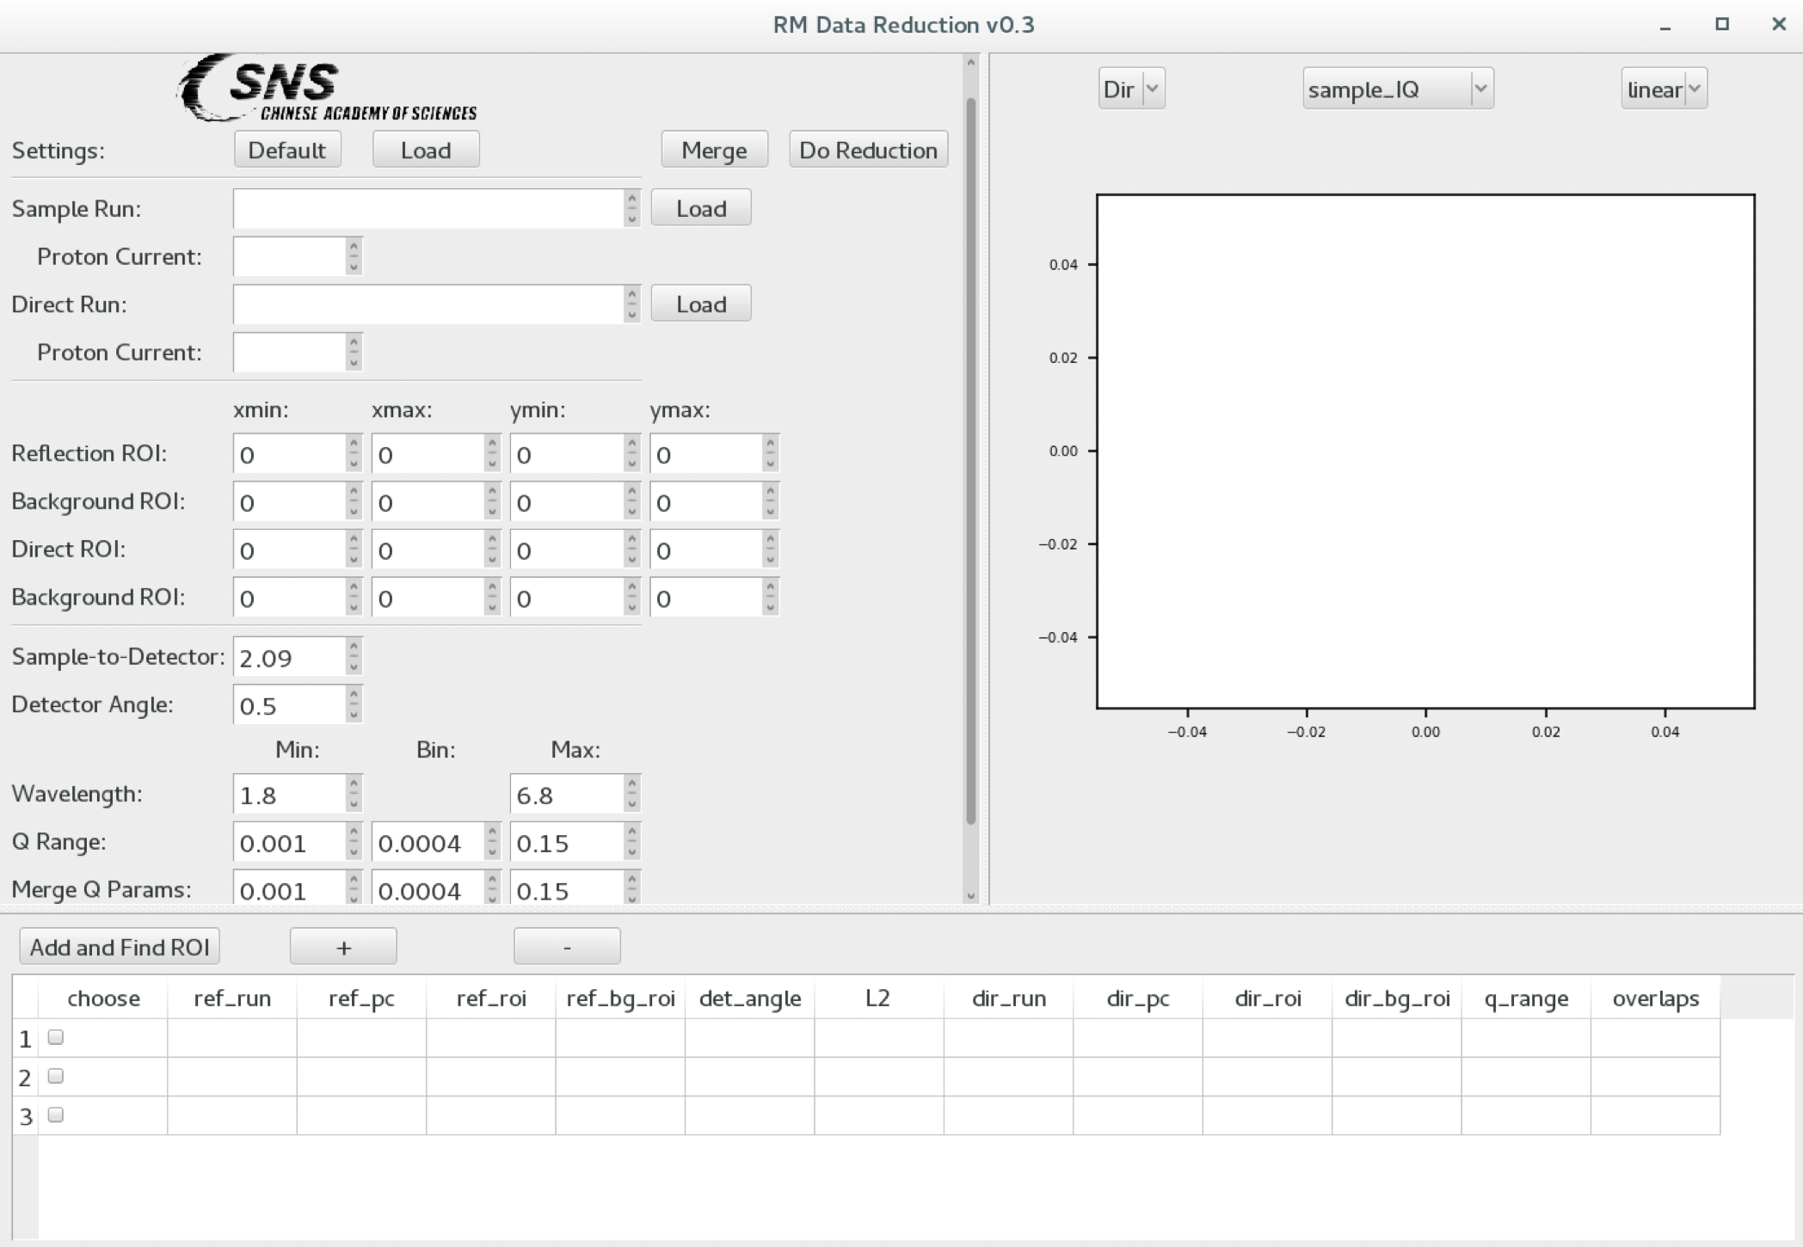
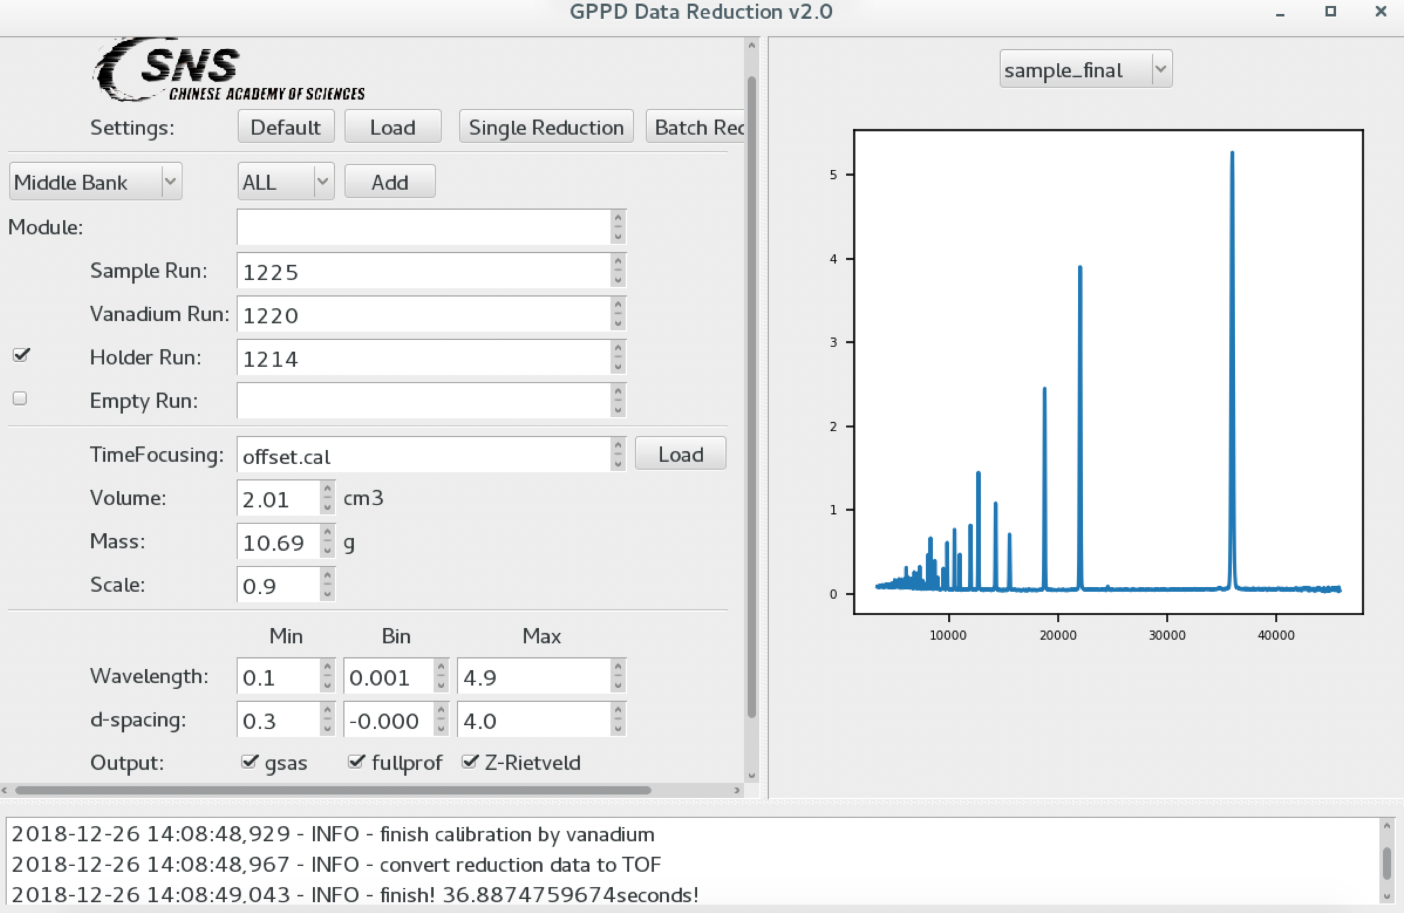
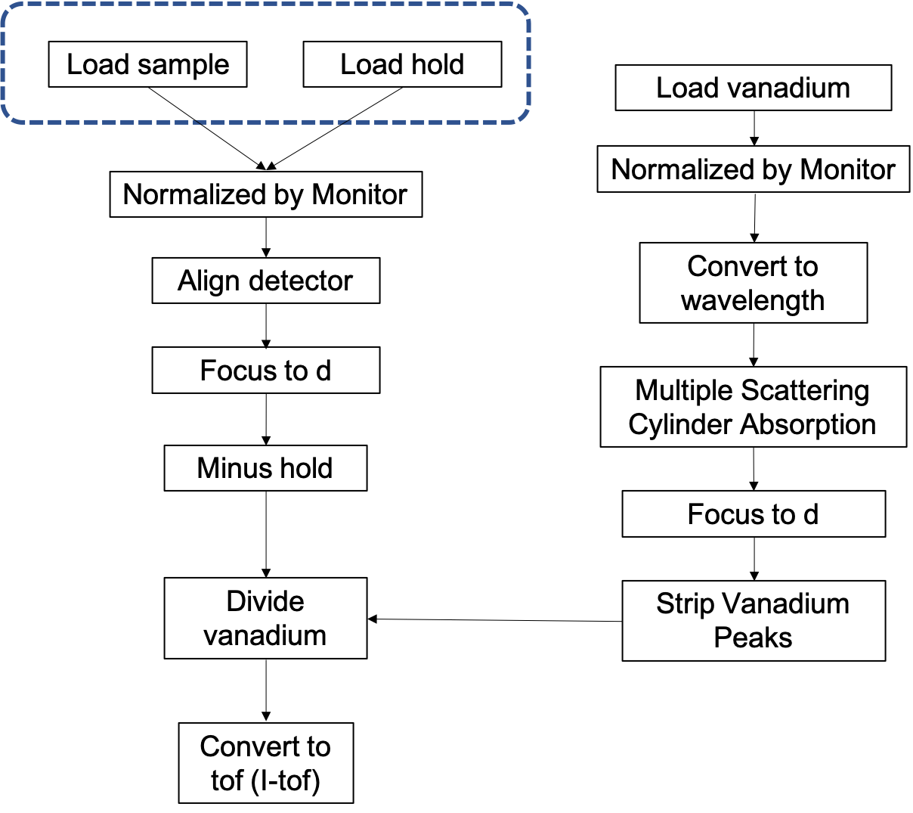
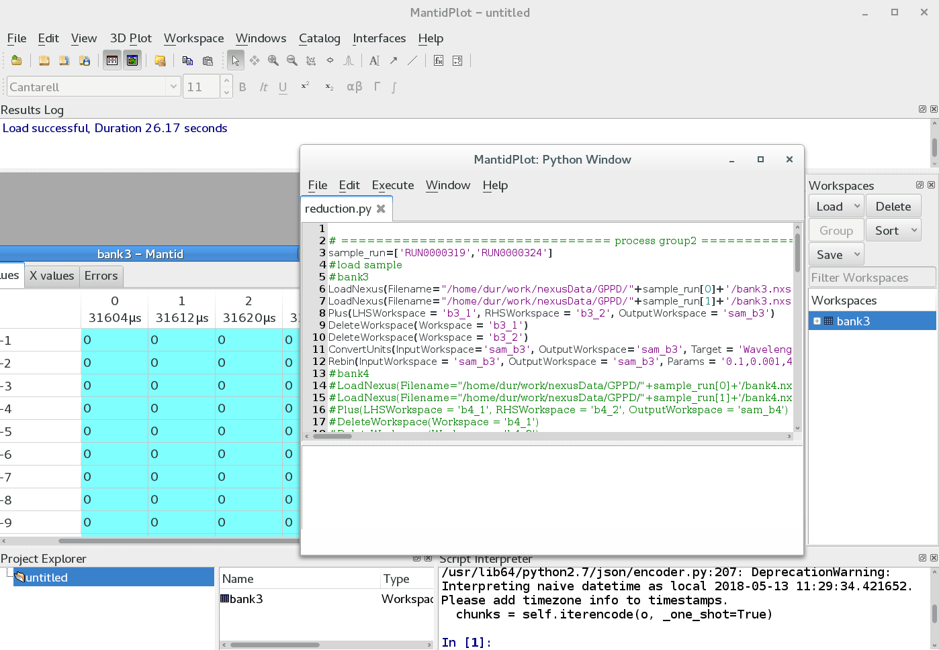
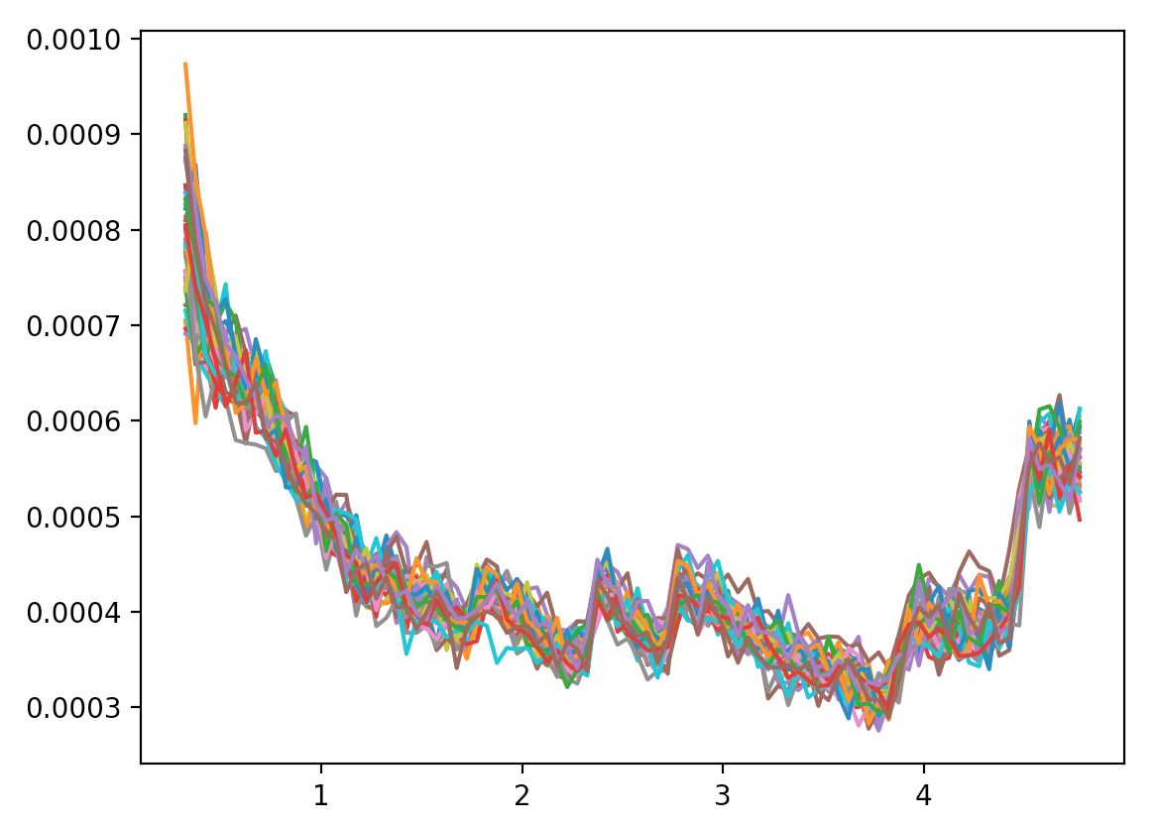
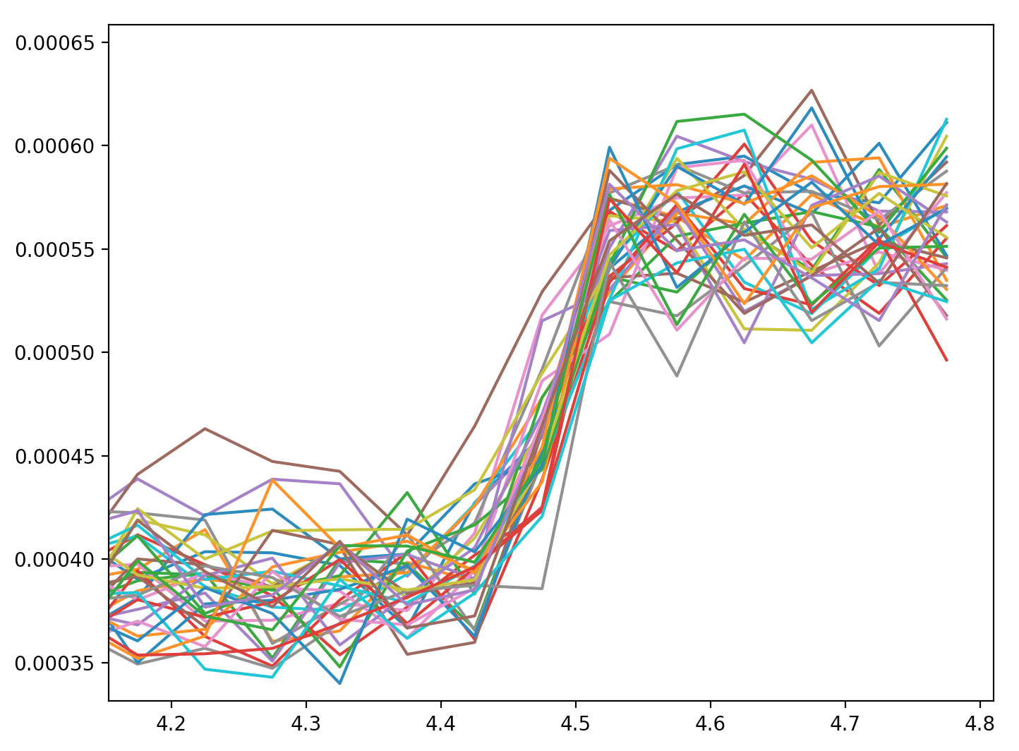
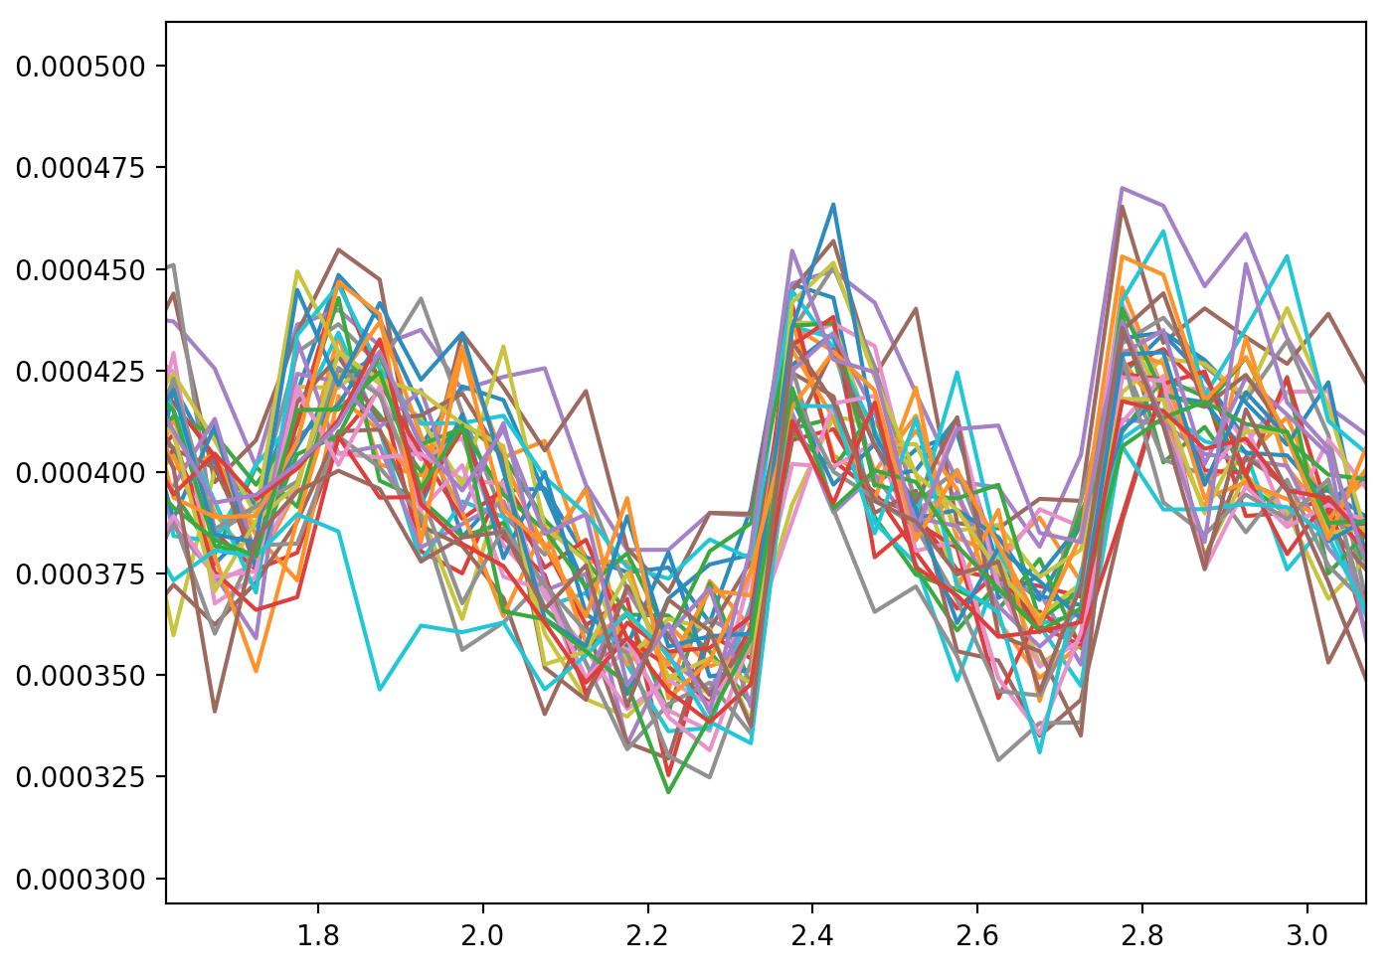
Reduction: base on mantid
Standard GUI
Python script

Slide 11
Outline
CSNS
overview
Data analysis
Online software
Offline software
User system and data management
User service platform
Data portal
Unified authentication
Data management

Slide 12
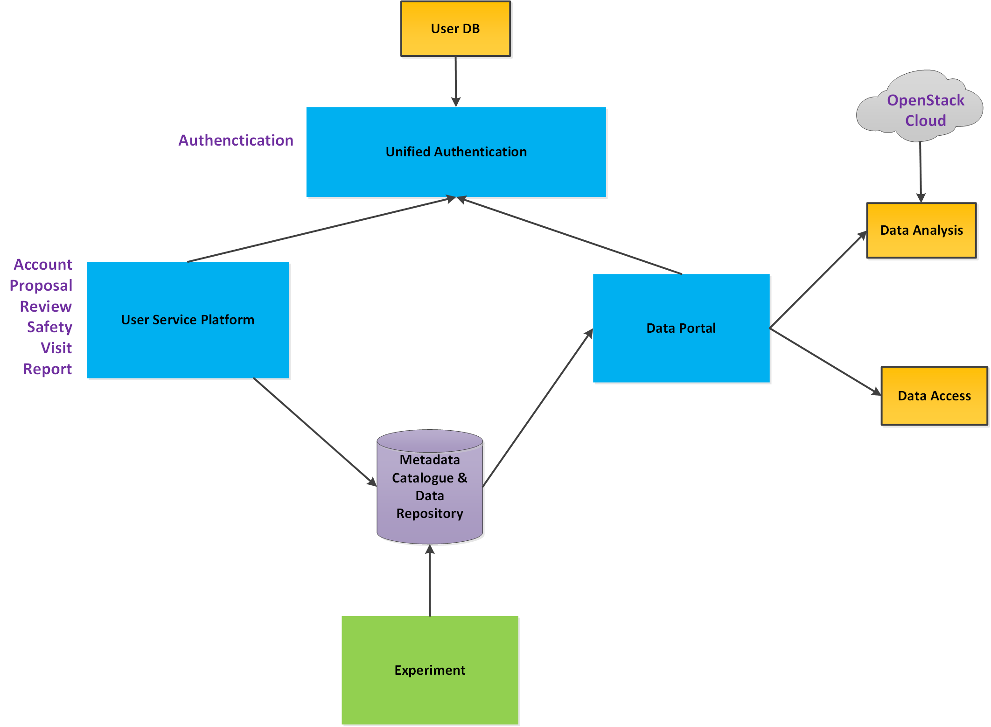
User System
Provide the CSNS facility users with supports in all aspect, from proposal, visit, experiment, data, analysis, to publication.
12

Slide 13
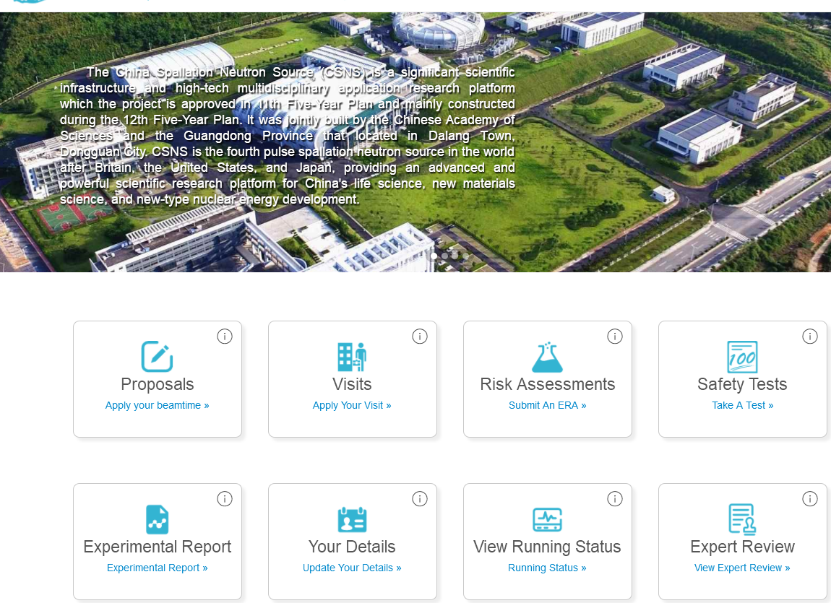
User Service Platform
Workbench
Platform for:
Experiment arrangement
Proposal Application
Visit
Safety Test
Proposal review and assessment
Proposal Apply
Proposal-Review Panel
Offline review meeting
User office preview
Feasibility review
Final approval
Safety tests during proposal application
Start applying
Application completed
13

Slide 14
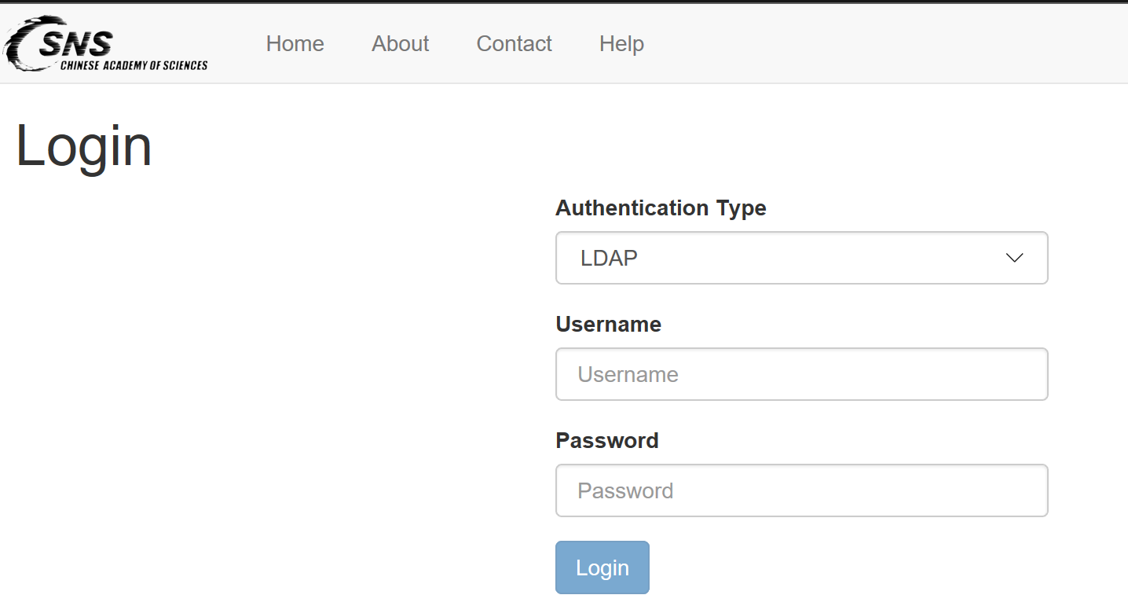
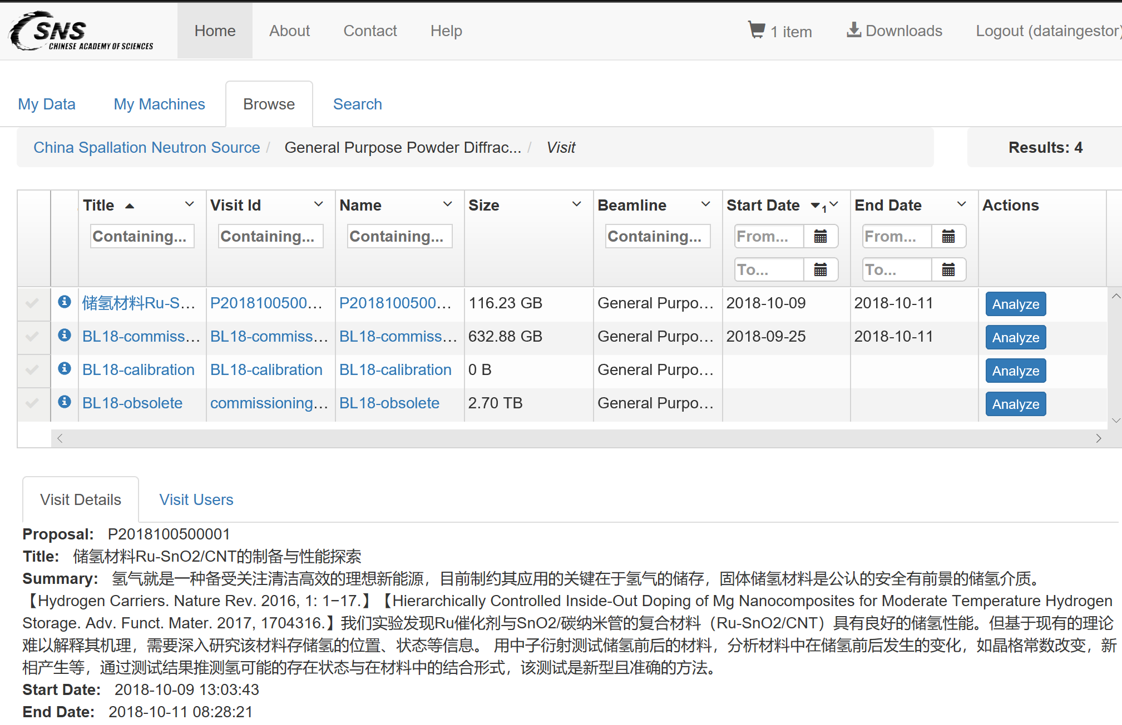
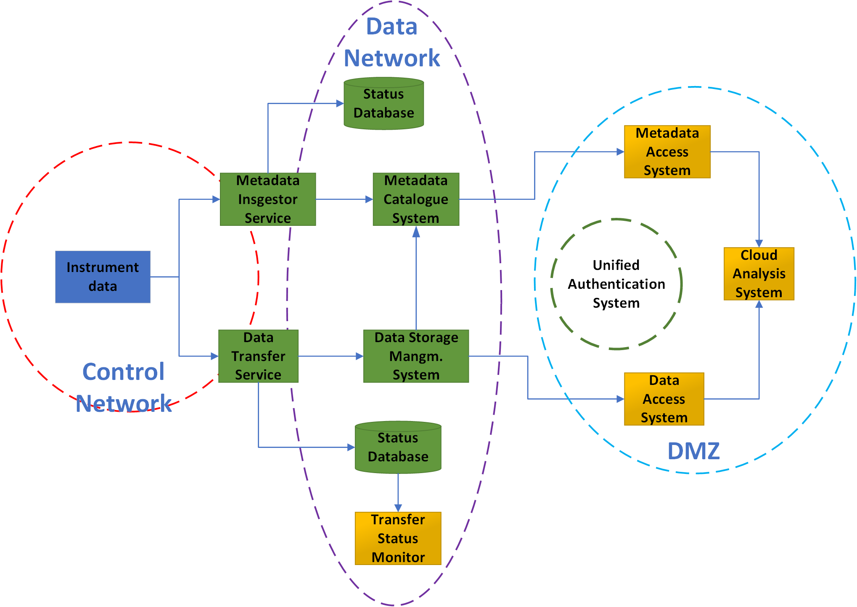
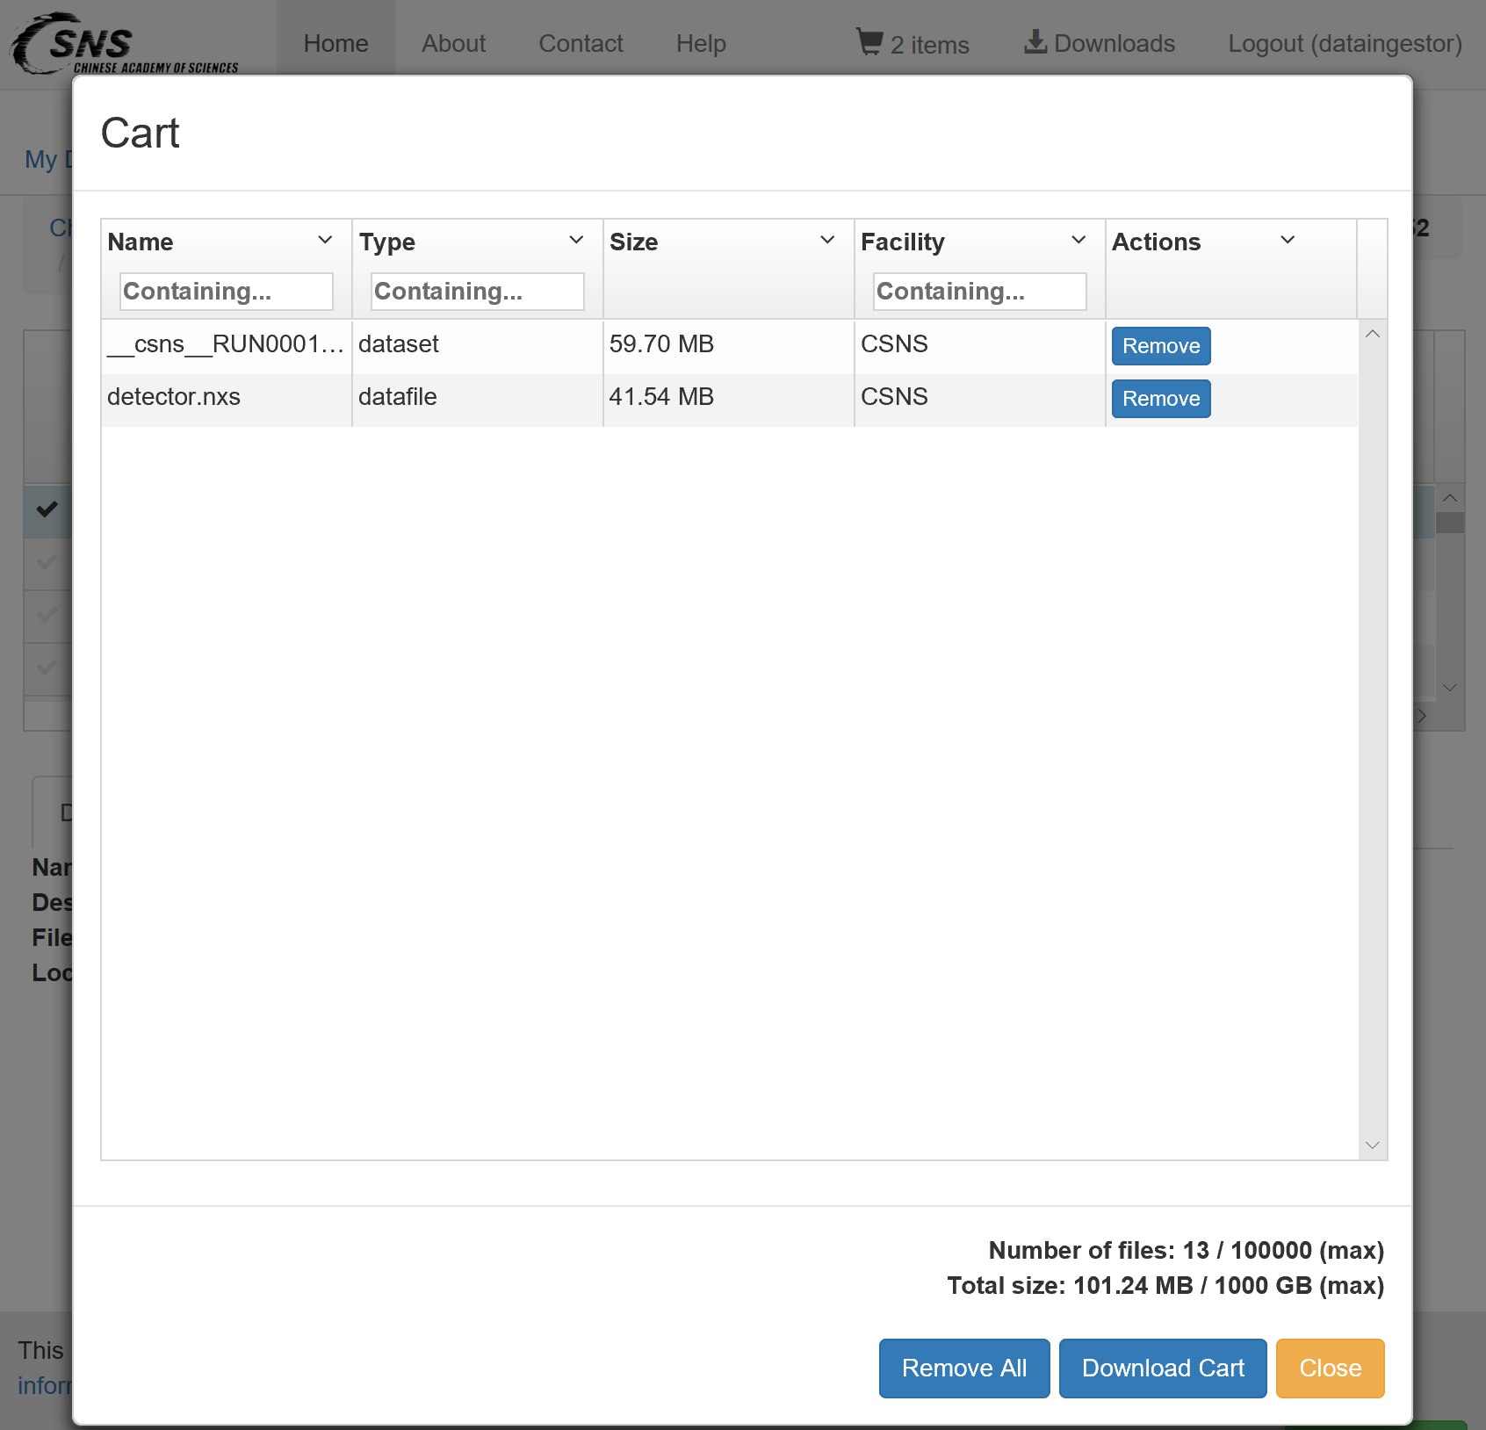
Data Portal: Data Access
Data all in one portal:
TopCAT based
Metadata & data
Browser, download, search
Analysis
…
14

Slide 15
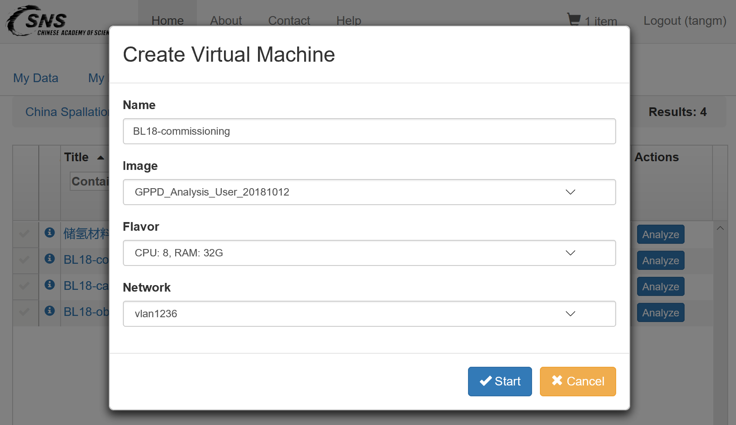
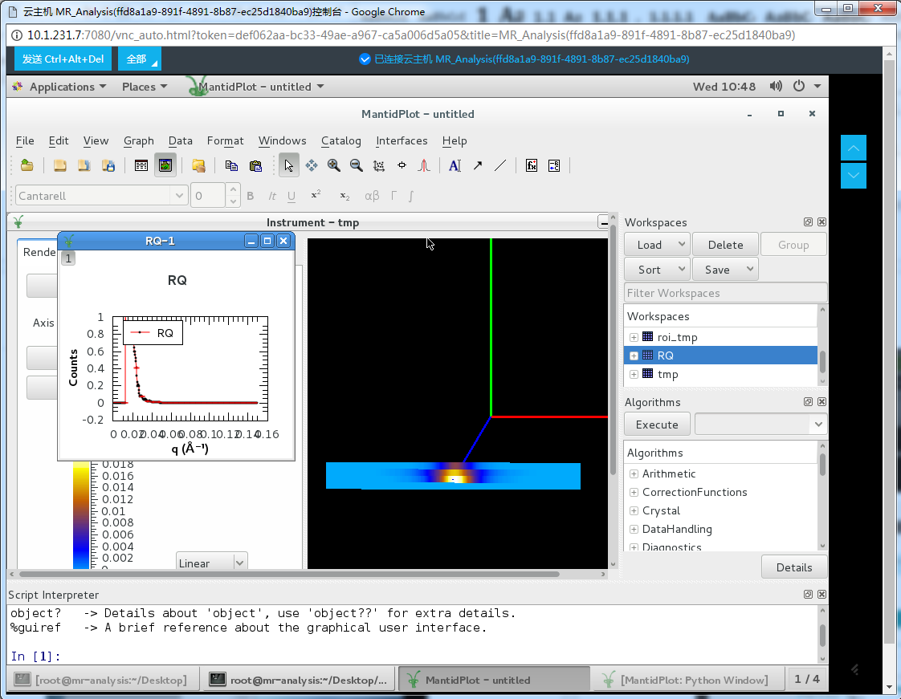
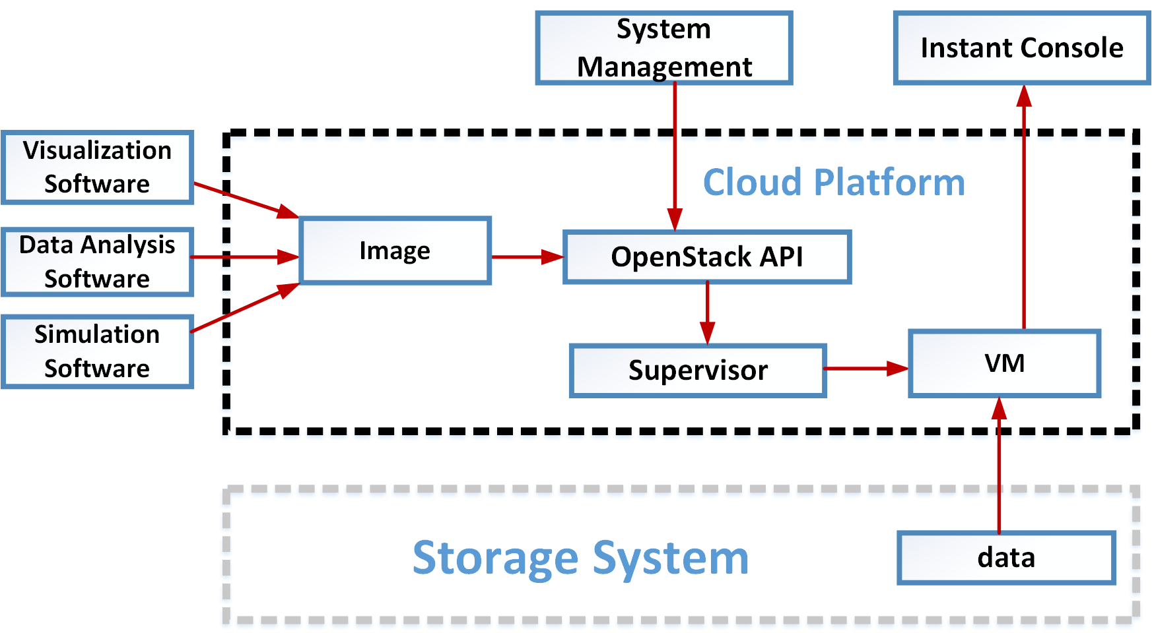
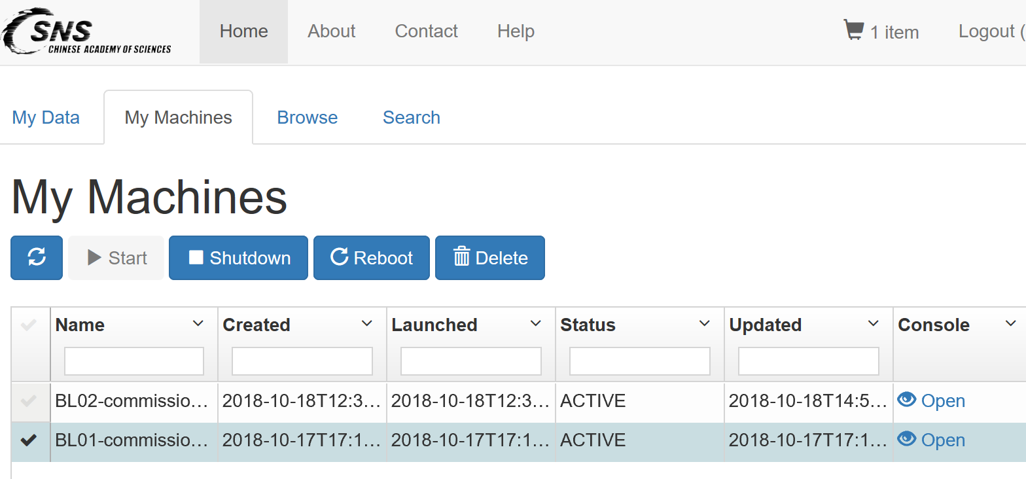
Data Portal: Data Cloud Analysis
Cloud Analysis:
OpenStack based
Web Console
VM management
Integrated with Data Access
15

Slide 16
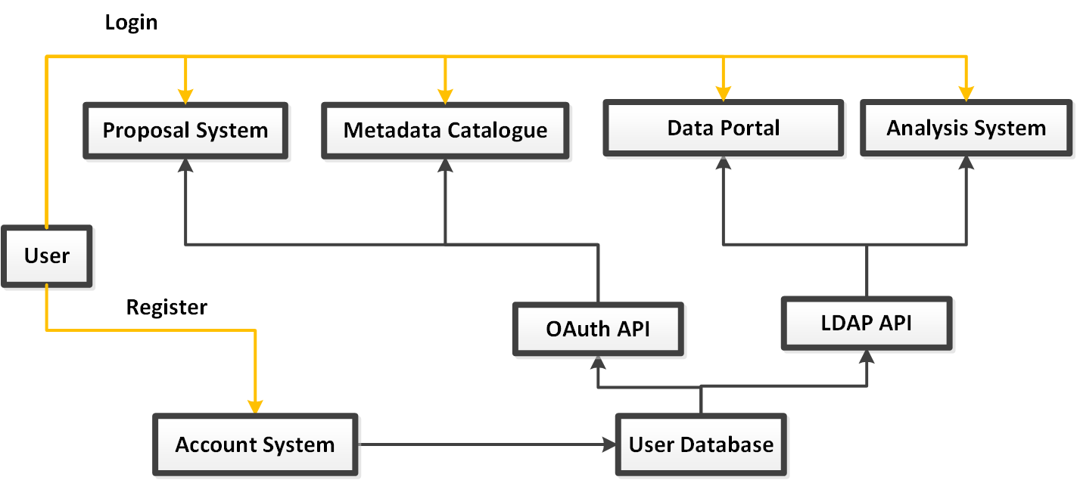
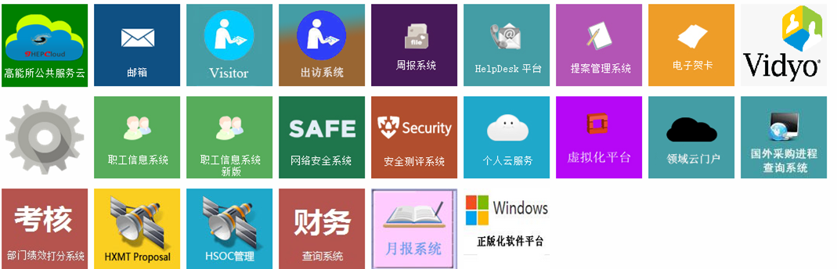


Unified Authentication System
CSNS Cloud
User Service Platform
Data Portal
Gitlab
VPN
…

Slide 17
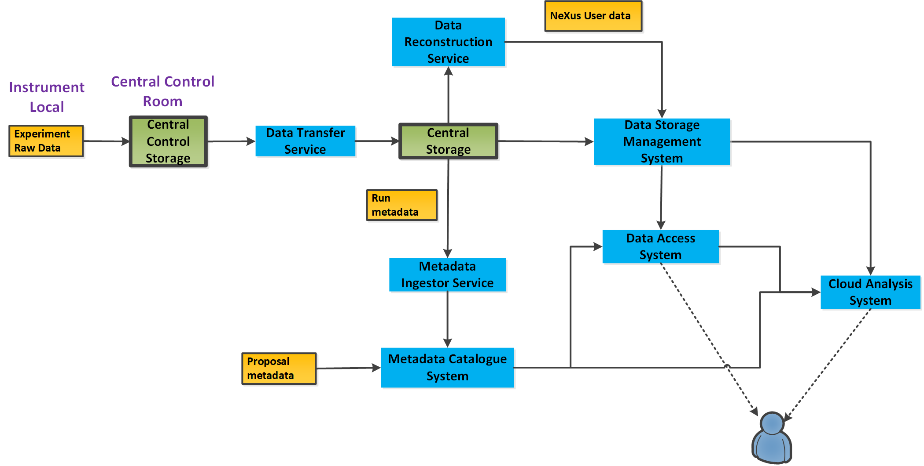
Data Management: System Overview
Central Control Storage
Central Data Storage
Data Transfer
Data Reconstruction
Metadata Catalogue
Data Storage Management
Data Access
Data Cloud Analysis
Framework & Data flow

Slide 18
Thank you

